Slide 1
XFT: Practical Fault Tolerance Beyond Crashes [LCV16]
COS 518: Advanced Computer Systems
James Heppenstall & Suriya Kodeswaran
May 13, 2019
Notes:
Presentation Order
Slides 2-4: Suriya
Slides 5-6: Jamie
Slides 7-8: Suriya
Slides 9-10: Jamie
Slides 11-12: Suriya
Slides 13-14: Jamie
Slides 15-16: Suriya

Slide 2
Motivation
Trend: BFT is not widely adopted in industry to solve the SMR problem
Mainly due to additional cost in terms of resources, complexity, and performance
But Byzantine faults are common!
Malicious adversaries, faulty hardware, software bugs, human error, etc.

Slide 3
Previous Solutions
Crash Fault-Tolerance (CFT)
Paxos [Lam88]
Zab [JRS11]
Raft [OO14]
Byzantine Fault-Tolerance (BFT)
PBFT [CL99]
Zyzzyva [KAD07]
Chain/Aliph [RHS12]
We want something in between!
Notes:
It is worth noting that all of the above solutions to the SMR problem assume an asynchronous network model, in which packets are not guaranteed to arrive within a specified time frame, and could be reordered or even dropped.

Slide 4
Key Idea
CFT is too optimistic and BFT is too pessimistic
So the paper introduces an intermediate system model
…and a new consensus protocol
Cross Fault-Tolerance (XFT)
Clients and replicas can suffer Byzantine faults
All replicas share reliable bi-directional communication channels
An eventually synchronous network model

Slide 5
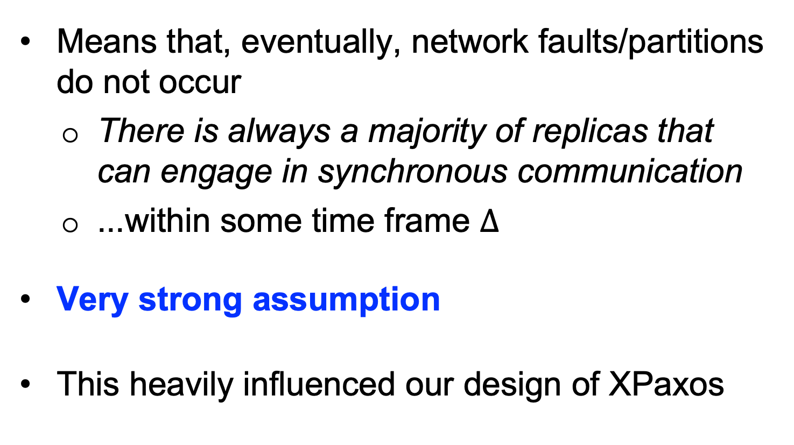
Eventually Synchronous Network Model
Means that, eventually, network faults/partitions do not occur
There is always a majority of replicas that can engage in synchronous communication
...within some time frame $Δ$
Very strong assumption
This heavily influenced our design of XPaxos
Notes:
Since XPaxos assumes a strong network model, we implement a “dummy” network in Go (using channels) for testing and benchmarking.
This gives us fine-grained control over the RPCs being sent over the network, in particular, the time frame $Δ$.

Slide 6
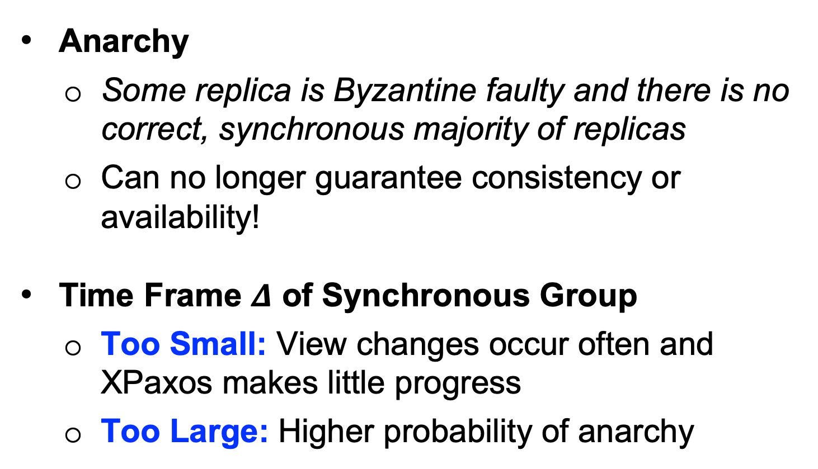
Key Considerations
Anarchy
Some replica is Byzantine faulty and there is no correct, synchronous majority of replicas
Can no longer guarantee consistency or availability!
Time Frame $Δ$ of Synchronous Group
Too Small: View changes occur often and XPaxos makes little progress
Too Large: Higher probability of anarchy

Slide 7
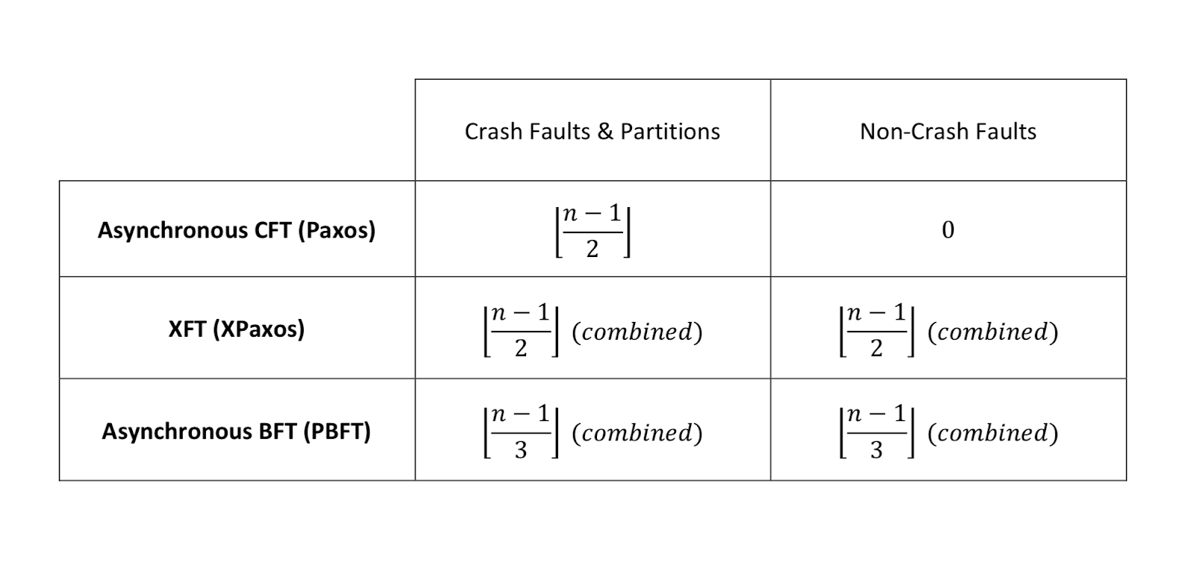
Comparison of SMR Protocols
Figure: Maximum number of faults before availability guarantees dissolve for the SMR protocols under evaluation ($n$ represents number of replicas)

Slide 8
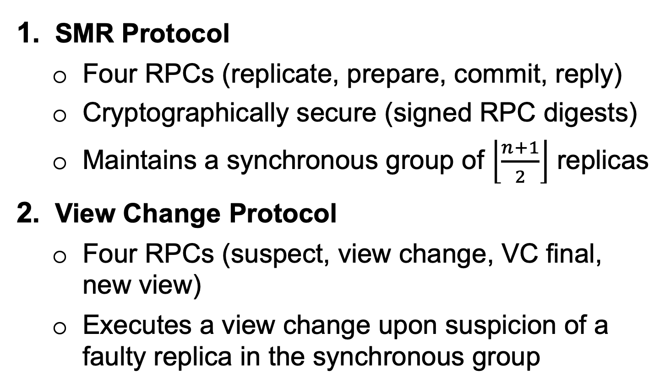
XPaxos System Architecture
SMR Protocol
Four RPCs (replicate, prepare, commit, reply)
Cryptographically secure (signed RPC digests)
Maintains a synchronous group of $\left\lfloor \frac{n+1}{2}\right\rfloor$ replicas
View Change Protocol
Four RPCs (suspect, view change, VC final, new view)
Executes a view change upon suspicion of a faulty replica in the synchronous group
Notes:
XPaxos is the first implementation of XFT.
Optimizations:
Request Retransmission Protocol
Fault-Detection Protocol
Checkpointing, Lazy Replication, Batching/Pipelining

Slide 9
SMR Protocol
Replicate
Prepare
Commit
Reply
Notes:
It is worth noting that XPaxos is optimized for the case where there are only 3 replicas (i.e. synchronous group consists of 2 replicas).

Slide 10
View Change Protocol
Suspect
View Change
VC Final
New View
Notes:
It is worth noting that XPaxos is optimized for the case where there are only 3 replicas (i.e. synchronous group consists of 2 replicas).

Slide 11
Implementation
We implemented XPaxos from scratch in Go
Implemented the SMR and view change protocols
Simulated a “dummy” network of clients and replicas with the net/rpc package
Verified correctness of both CFT and BFT properties of XPaxos with the testing package
Ran evaluation benchmarks with the testing package
Excluded optimizations (next slide)
We implemented an abridged version of PBFT and tailored an open-source implementation of Paxos for our evaluation (both unoptimized)

Slide 12
Further Work
Potential Optimizations
Fault-Detection Protocol
Checkpointing and Garbage Collection
Lazy Replication
Batching/Pipelining

Slide 13
Evaluation

Slide 14
Evaluation

Slide 15
Evaluation

Slide 16
Evaluation

Slide 17
Thank You!
Any Questions?

Slide 18
References
Git Repo: https://github.com/JamesHeppenstall/cos518_project
[LCV16] https://www.usenix.org/system/files/conference/osdi16/osdi16-liu.pdf
[Lam88] http://lamport.azurewebsites.net/pubs/lamport-paxos.pdf
[JRS11] https://lamport.azurewebsites.net/pubs/lamport-paxos.pdf
[OO14] https://web.stanford.edu/~ouster/cgi-bin/papers/raft-atc14
[CL99] http://pmg.csail.mit.edu/papers/osdi99.pdf
[KAD07] http://www.cs.cornell.edu/lorenzo/papers/kotla07Zyzzyva.pdf
[RHS12] http://www.cs.cornell.edu/~ns672/publications/2012OPODIS.pdf

